Slide 1
Preparing Data and Feature Engineering

Slide 2
Data Science: Reality VS. Myth

Slide 3
FEATURE ENGINEERING

Slide 4
Feature Engineering
The first step in data analytics is almost always feature engineering.
The features in your data will directly influence the predictive models you use and the results you can achieve.
the better the features, the better the results.
Definitions
Feature engineering is the process of transforming raw data into features that better represent the underlying problem to the predictive models, resulting in improved model accuracy on unseen data.
feature engineering is manually designing what the input x’s should be {Tomasz Malisiewicz , answer to “What is feature engineering?”}

Slide 5
Feature Engineering
Features are the independent variables that are used to predict an outcome (or dependent variable) in predictive modelling. There is some art involved in deciding which features to use. Practitioners call upon their “Domain Knowledge”, that is, knowledge of the business, science or social science subject matter, to determine what features to use. Some examples are:
Macroeconomic variables as predictors of credit default rates
Properties of molecules as predictors of toxicity in drug discovery
Pixel values as predictors of photograph picture content
Data scientists often spend time thinking of original features and the best places to source the data

Slide 6
Feature Engineering
Other Feature Engineering
Pictures i.e. edge detection from open CV,
word2vec, doc2vec etc
Combinations of features

Slide 7
DATA CLEANING

Slide 8
Data Pre-processing
Data examination:
Accuracy: correct, accurate,..
Completeness: not recorded values, unavailable, ..
Consistency
Interpretability: how easily the data can be understood.
Normalization: features that have different orders of magnitude need to be scaled for many analyses so that the effects of one feature do not make the effects of a smaller feature difficult or impossible to detect
Data Cleaning

Slide 9
Cleaning Data
An integral part of data preprocessing is data cleaning (data cleansing or data scrubbing).
It is the process of removing invalid data points from a dataset
"Dirty” data is removed or corrected such that the outcome of the prediction process if not badly affected.
Common reasons to clean data
Missing Data
Outliers
Unexpected Values
Consistency between different sources (i.e. currency mismatch)
Concatenating sources
Data Type errors
Duplicate rows

Slide 10
Cleaning Data
Load Data Set for illustration: Titanic Survival Data Enter the following commands: import pandas as pd data = pd.read_csv("Titanic_altered_NI.csv") df = pd.DataFrame(data) print(df.columns)

Slide 11
Dealing with Missing Values - Methods
Replace with mean, median, interpolation, remove from dataset : each of these choices is associated with various trade-offs.
Method | Strengths | Weaknesses | Python
Mean | Averages of numerical data are used in many computations that will need to be done with numerical data, replacing with average value will not distort | Skewed by outliers Only meaningful for rational data types (i.e. float, int) and possibly interval, but not nominal (categorical) or ordinal | mean_age = df.Age.mean() df.Age = df.Age.fillna(mean_age)

Slide 12
Dealing with Missing Values - Methods
Replace with mean, median, interpolation, remove from dataset : each of these choices is associated with various trade-offs.
Method | Strengths | Weaknesses | Python
Median | Robust to outliers | May not be appropriate for datasets with “skewed’ distributions (i.e. poisson) in certain applications | med_age = df.Age.median()

Slide 13
Dealing with Missing Values - Methods
Replace with mean, median, interpolation, remove from dataset : each of these choices is associated with various trade-offs.
Method | Strengths | Weaknesses | Python
Mode | Using the most frequent value in a large dataset will not usually distort the average or other values too greatly | May not be appropriate for datasets with kurtosis (i.e. stable distributions ) in certain applications | mod_age = df.Age.mode()[0] *Mode returns a series

Slide 14
Dealing with Missing Values - Methods
Replace with mean, median, interpolation, remove from dataset : each of these choices is associated with various trade-offs.
Method | Strengths | Weaknesses | Python
Remove | Does not introduce any bias if missing values are randomly distributed | Selection bias may occur if missing values are concentrated among population subgroups (i.e. mostly older or mostly younger patients in a medical database) | A = df.dropna(how='all') df.dropna(how='any') df.dropna(thresh=2)

Slide 15
Pandas Data Frames and Useful Commands
Some commands that can be used to understand your data set. This can help you decide how to best handle missing values and other data cleaning tasks we will discuss in this lecture
df.head() (method)
df.tail() (method)
df.columns (attribute)
df.shape (attribute)
df.info()
df.column.value_counts(dropna=False)
df.describe()
Try these commands on the Titanic Data Set

Slide 16
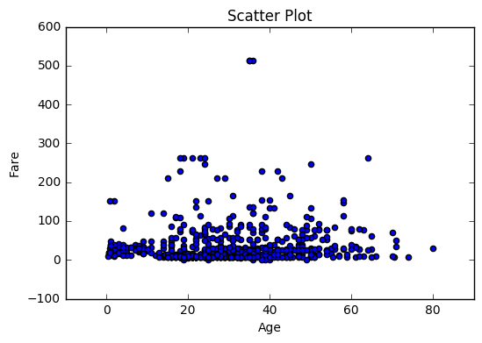
Visualizing Data with Graphs
Some commands that can be used to visualize your data set
import matplotlib.pyplot as plt
Plot | Strengths | Weaknesses | Python
Scatter | Visualize relationships between variables, see outliers | Not useful for categorical or single variables, visualization mostly useful only for 2 or 3 variables at a time | plt.scatter(data.Age,data.Fare) Title = "Scatter Plot“ Xlab = "Age“ Ylab = "Fare“ plt.title(Title) plt.xlabel(Xlab) plt.ylabel(Ylab) plt.show()

Slide 17
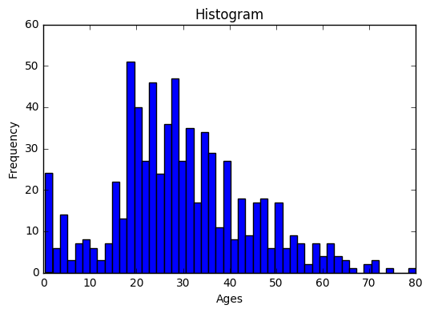
Visualizing Data with Graphs
Some commands that can be used to visualize your data set
import matplotlib.pyplot as plt
Plot | Strengths | Weaknesses | Python
Histogram | Find distribution of a single variable, see outliers | Bin size must be carefully chosen | ages = data.Age agesclean = ages.dropna(how = "all") plt.hist(agesclean, bins = 50) Title = "Histogram“ Xl = "Ages“ Yl ="Frequency“ plt.title(Title) plt.xlabel(Xl) plt.ylabel(Yl)

Slide 18
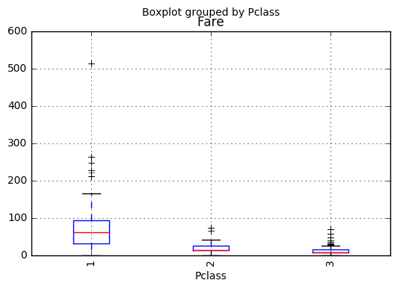
Visualizing Data with Graphs
Some commands that can be used to visualize your data set
Plot | Strengths | Weaknesses | Python
Box Plot | Visualize coarse grained distribution of numerical data by category, see outliers Can handle several categorical variables | Distribution is only min, max, quartiles and outliers | data.boxplot( column='Fare’, by='Pclass', rot=90)

Slide 19
Data cleaning/Data Visualization
Outliers:
An outlier is an observation that lies an abnormal distance from other values in a random sample from a population. In a sense, this definition leaves it up to the analyst (or a consensus process) to decide what will be considered abnormal. Before abnormal observations can be singled out, it is necessary to characterize normal observations.
Source: NIST Engineering Statistics Handbook: http://www.itl.nist.gov/div898/handbook/prc/section1/prc16.htm

Slide 20
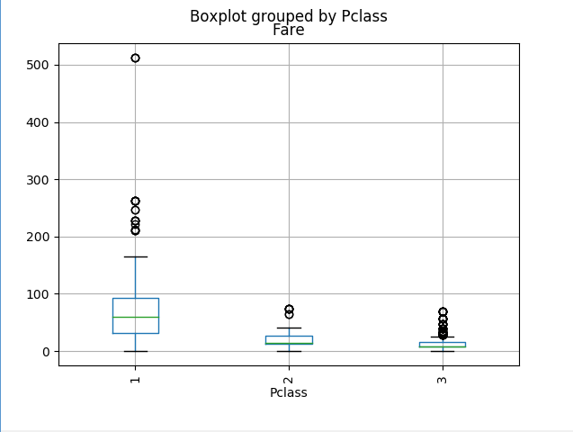
Data cleaning/Data Visualization
Outliers (2)
Outliers may be found using visual inspection
For example, a box plot may be used to visually inspect the Titanic dataset:
Outlier

Slide 21
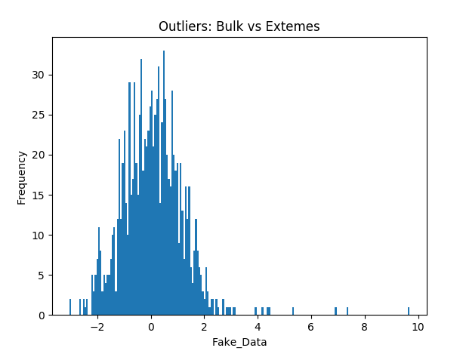
Data cleaning/Data Visualization
Or outliers can be defined as having less than a certain probability of occurring
define outlier as a point with less than 0.1% chance of occurring , assuming a Gaussian distribution with mean 0 and Stdev = 1
Outliers

Slide 22
Data scales
Nominal: no implication for quantity (qualitative)
Ordinal: relative ranking among values
Interval: like the ordinal scale but with uniform difference, i.e. a unit of measurement exists.
Ratio: strongest scale, like the interval in terms of order and uniformity but the scale has an absolute zero.

Slide 23
Categorical Data
Categorical features are features that are non-numeric and describe categories. Which columns in the Titanic Dataset relate to categorical features?
categorical = df.dtypes[df.dtypes == “object”].index
print(categorical)
df[categorical].describe()

Slide 24
Categorical Data
Categorical features must be transformed into numerical features to be useful in most types of analysis. One method for doing this is called dummy coding, also known as “one hot” encoding. Pandas makes this very easy:
print(pd.get_dummies(data,columns=[‘Sex]).head())
One hot encoding transforms categorical features into a series of variables with a status of ‘0’ or ‘1’. Enter the above into the python interpreter for the column ‘Embarked’

Slide 25
Categorical Data
Categorical features must be transformed into numerical features to be useful in most types of analysis. Another method for doing this is to transform the data into numerical labels. This is known as label encoding.
data["Embarked"] = data["Embarked"].astype('category')
print(data.dtypes)
data["Embarked_cat"] = data["Embarked"].cat.codes
print(data.head())
Enter the above into the interpreter/script in order to perform label encoding on the “Embarked” category

Slide 26
FEATURE Selection

Slide 27
Feature Selection
Which features should you use to create a predictive model?
What is Feature Selection
Feature selection is also called variable selection or attribute selection.
It is the automatic selection of attributes in your data (such as columns in tabular data) that are most relevant to the predictive modeling problem you are working on.
“feature selection… is the process of selecting a subset of relevant features for use in model construction” — Feature Selection, Wikipedia entry.
“Feature selection is itself useful, but it mostly acts as a filter, muting out features that aren’t useful in addition to your existing features.”— Robert Neuhaus, in answer to “How valuable do you think feature selection is in machine learning?”

Slide 28
Feature Selection
The Problem The Feature Selection Solves
Feature selection methods aid you in your mission to create an accurate predictive model. They help you by choosing features that will give you as good or better accuracy whilst requiring less data.
Feature selection methods can be used to identify and remove unneeded, irrelevant and redundant attributes from data that do not contribute to the accuracy of a predictive model or may in fact decrease the accuracy of the model.
Fewer attributes is desirable because it reduces the complexity of the model, and a simpler model is simpler to understand and explain.
“The objective of variable selection is three-fold: improving the prediction performance of the predictors, providing faster and more cost-effective predictors, and providing a better understanding of the underlying process that generated the data.”— Guyon and Elisseeff in “An Introduction to Variable and Feature Selection”

Slide 29
Feature Selection Algorithms
Filter Methods: Filter feature selection methods apply a statistical measure to assign a scoring to each feature. The features are ranked by the score and either selected to be kept or removed from the dataset. The methods are often univariate and consider the feature independently, or with regard to the dependent variable.
Some examples of some filter methods include the Chi squared test, information gain, correlation coefficient scores and Variance Threshold.

Slide 30
Feature Selection Algorithms
Wrapper Methods: Wrapper methods consider the selection of a set of features as a search problem, where different combinations are prepared, evaluated and compared to other combinations. A predictive model us used to evaluate a combination of features and assign a score based on model accuracy.
The search process may be methodical such as a best-first search; it may be stochastic such as a random hill-climbing algorithm, or it may use heuristics, like forward and backward passes to add and remove features.
An example if a wrapper method is the recursive feature elimination algorithm.

Slide 31
Feature Selection Algorithms
Embedded Methods: Embedded methods learn which features best contribute to the accuracy of the model while the model is being created. The most common type of embedded feature selection methods are regularization methods.
Regularization methods are also called penalization methods that introduce additional constraints into the optimization of a predictive algorithm (such as a regression algorithm) that bias the model toward lower complexity (fewer coefficients).
Examples of regularization algorithms are the LASSO, Elastic Net and Ridge Regression.

Slide 32
Discussion and Lab
Use the method df.column.value_counts(dropna=False) to find the missing values for the columns of the Titanic Dataset
Apply the plotting techniques and other commands presented in this chapter to determine how best to deal with the missing values in the Titanic Dataset
Replace the missing values with the appropriate method
Support and explain the reasoning behind your choice for each column using at least 1 graphical method for each column, where appropriate, as well as the info() and describe() methods where appropriate
Please hand in your work as part of the assignment at the end of the class

Slide 33
APPENDIX

Slide 34
Gritty Cleaning
If you expect the data type of a column to be numeric (int or float), but instead it is of type object, this typically means that there is a non numeric value in the column. This could also be a sign of bad data.
Take a look at the Fare-bad column in the Titanic dataset:
data['Fare-bad'][:20]
type(data['Fare-bad'][16])
data.info()
Notice that the data type of the Fare-bad column is “object”. This is because a “$” in row 16 causes that value to be read as a string. Use the to_numeric method:
data['Fare-bad'] = pd.to_numeric(data['Fare-bad'], errors = 'coerce’)
data['Fare-bad'][:20]
data.info()
What does the coerce keyword do? Do you think this is bad data?

Slide 35
Gritty Cleaning – Using Regular Expressions
A $ causes good numerical data to appear as type string and mixed data to appear as type object when uploaded to Python. Instead of replacing this with ‘NaN’, we can use regular expressions in Python to remove the ‘$’ and salvage our numerical data.
Import re
pattern = re.compile('\$\d*\.\d{2}’)
The re package in Python has a number of functions for pattern matching and string manipulation that are very useful in Python. Compile creates a pattern object that can be used for matching strings to a pattern that is described as an argument

Slide 36
Gritty Cleaning
A $ causes good numerical data to appear as type string and mixed data to appear as type object when uploaded to Python. Instead of replacing this with ‘NaN’, we can use regular expressions in Python to remove the ‘$’ and salvage our numerical data.
Import re
pattern = re.compile('\$\d*\.\d{2}’)
The \$ matches a dollar sign at the string position where it is placed. (If the dollar sign appears without the escape character it is a direction to match from the end of the string)

Slide 37
Gritty Cleaning
A $ causes good numerical data to appear as type string and mixed data to appear as type object when uploaded to Python. Instead of replacing this with ‘NaN’, we can use regular expressions in Python to remove the ‘$’ and salvage our numerical data.
Import re
pattern = re.compile('\$\d*\.\d{2}’)
The \d* matches any number of digits

Slide 38
Gritty Cleaning
A $ causes good numerical data to appear as type string and mixed data to appear as type object when uploaded to Python. Instead of replacing this with ‘NaN’, we can use regular expressions in Python to remove the ‘$’ and salvage our numerical data.
Import re
pattern = re.compile('\$\d*\.\d{2}’)
The \. matches a period in the position where it is placed in the pattern. (Without the escape character, the period matches any one character)

Slide 39
Gritty Cleaning
A $ causes good numerical data to appear as type string and a mixed data column to appear as type object when uploaded to Python. Instead of replacing this with ‘NaN’, we can use regular expressions in Python to remove the ‘$’ and salvage our numerical data.
Import re
pattern = re.compile('\$\d*\.\d{2}’)
The \d{2} matches 2 digits. \d{3} would match 3 digits etc.

Slide 40
Gritty Cleaning
A $ causes good numerical data to appear as type string and mixed data to appear as type object when uploaded to Python. Instead of replacing this with ‘NaN’, we can use regular expressions in Python to remove the ‘$’ and salvage our numerical data.
Import re
pattern = re.compile('\$\d*\.\d{2}’)
The match method is used to determine if a string matches the pattern:
yn = bool(pattern.match(data['Fare-bad'][16]))
Yn
Apply the bool function to convert the output from match to a Boolean value from a memory location.

Slide 41
Gritty Cleaning
A $ causes good numerical data to appear as type string and mixed data to appear as type object when uploaded to Python. Instead of replacing this with ‘NaN’, we can use regular expressions in Python to remove the ‘$’ and salvage our numerical data.
Import re
pattern = re.compile('\$\d*\.\d{2}’)
The findall method returns all matches in string as a list:
re.findall(pattern, ‘The potatoes cost $2.35 and the tomatoes cost $3.00’)
Out[56]: ['$2.35', '$3.00']

Slide 42
Gritty Cleaning – Using Functions
Functions are defined in python using the following syntax:
def fncn(arg1, arg2):
#body …
…
Return value #note the indentation
‘def’ is a keyword used to define a function and fncn is the name of the function, arg1 and arg2 are the inputs. At the end of execution, value is returned from the function. To apply this to clean the Fare-bad column in the Titanic data set we will input the row to be cleaned and the pattern to be matched as arguments to the function we will build.

Slide 43
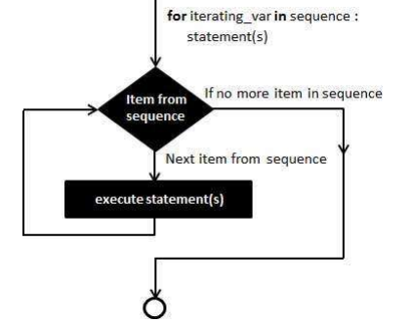
Gritty Cleaning – Using Functions
Now let’s define a function that uses a for loop to print out all of the fare data
def fncn(column, pattern):
for i in column:
print(i)
return
The for loop runs through every value
in the iterable, column. The syntax for
the for loop can also be expressed in
the following way:
for i in range(0,data.shape[0]):
print(data[‘Fare-bad’][i])

Slide 44
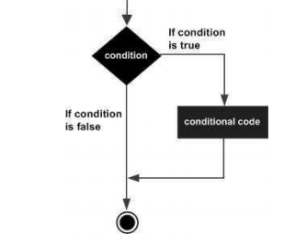
Gritty Cleaning – Using Functions
Now let’s define a function that uses a for loop to print out all of the fare data with dollar signs in front of them
def fncn(column, pattern):
for i in column:
if(pattern.match(i)):
print(i)
return
The conditional statement if is used to print
Only those data points matching the pattern.
The syntax of the if statement is:
if expression:
statement(s)
else:
statement(s)

Slide 45
Gritty Cleaning – Using Functions
Now let’s define a function that uses a for loop to replace all of the fare data with dollar signs in front of them
def fncn(column, pattern):
for i in column:
if(pattern.match(i)):
i = i.replace(“$”,””)
i = float(i)
return
The apply method can be used to apply a function with the correct structure to a column or row of data to clean the column or row. The axis argument is 0 by default, applying the function across a row of a dataset, axis = 1 applies the function down a column
data.apply(function_name, axis = 1, arguments =….)

Slide 46
Gritty Cleaning – Using Functions
We use the apply method to apply this function to the data in our data frame:
def fncn(row, pattern):
i = row['Fare-bad']
if(pattern.match(i)):
i = i.replace("$","")
i = float(i)
print(type(i))
else:
i = float(i)
return I
data['Fare-bad'] = data.apply(fncn, axis=1, pattern = pattern)
print(data.info())
Define the pattern in the earlier slides and use the apply function to clean the bad Fare data

Slide 47
Data cleaning/Data Visualization
Outliers (3)
Lab: Generate the “fake” dataset in the plot below to create data for which the bulk is distributed normally, but for which extreme values are distributed according to a pareto function:
import matplotlib.pyplot as plt
bulk = np.random.normal(0,1,1000)
#this is the main trend, which is standard Gaussian
extreme = np.random.pareto(0.99,50)
#these are the extreme outliers
bulkdata = pd.DataFrame(bulk)
extremedata = pd.DataFrame(extreme)
alldata = pd.concat([bulkdata, extremedata])
#we will cover concat soon
plt.hist(alldata, bins = 200)
#this is a histogram made using matplotlib
xlab = 'Fake_Data'
ylab = 'Frequency'
title = 'Outliers: Bulk vs Extemes'
plt.xlabel(xlab)
plt.ylabel(ylab)
plt.title(title)
plt.show()
Outliers

Slide 48
Data cleaning/Data Visualization
Outliers (3)
Find the probability of observing a data point in the extreme region and define outlier as a point with less than 0.1% chance of occurring from the bulk probability distribution
#find all points in alldata with less than 0.1% chance of occurring:
Import scipy as sp
outliers = sp.stats.norm(0,1).cdf(alldata)
print(alldata[outliers>0.999])
Outliers

Slide 49
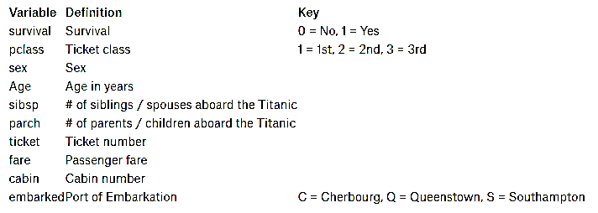
Data cleaning/Data Visualization
Suspicious values are values that don’t make common sense or which contradict domain knowledge
print(df.describe()) #describe the Titanic dataset
print(df[df.Fare>512][:]) #investigate the suspicious datapoint
PassengerId Survived Pclass Age SibSp \
count 891.000000 891.000000 891.000000 714.000000 891.000000
mean 446.000000 0.383838 2.308642 29.699118 0.523008
std 257.353842 0.486592 0.836071 14.526497 1.102743
min 1.000000 0.000000 1.000000 0.420000 0.000000
25% 223.500000 0.000000 2.000000 20.125000 0.000000
50% 446.000000 0.000000 3.000000 28.000000 0.000000
75% 668.500000 1.000000 3.000000 38.000000 1.000000
max 891.000000 1.000000 3.000000 80.000000 8.000000
Parch Fare
count 891.000000 891.000000
mean 0.381594 32.204208
std 0.806057 49.693429
min 0.000000 0.000000
25% 0.000000 7.910400
50% 0.000000 14.454200
75% 0.000000 31.000000
max 6.000000 512.329200

Slide 50
Merging, Concatenating and Dropping Duplicates
Concatenating data is appropriate for datasets that were once from the same dataset
Practice concatenating data with the Titanic Dataset by splitting the data into two new dataframes:
print(df.shape)
df1 = df[:445][:]
df2 = df[445:][:]
print(df2.tail())
dfnew = pd.concat([df1,df2]) # to concatenate files, pass a list of dataframes to pd.concat
print(dfnew.tail())
print(dfnew.shape) #type help(pd.concat) to learn additional parameters and uses
Lab exercise: repeat the same process for column-wise concatenation by slicing the dataframe into two dataframes of 6 columns each and then using the axis parameter.
Merging Data is appropriate for datasets with some similar variables or keys along with some complimentary observations, similar to ‘join’ in SQL
example = pd.merge(left= exlft, right= exrgt, left_on=‘column1', right_on=‘column2’)
example.drop_duplicates()

Slide 51
Gritty Cleaning
A $ causes good numerical data to appear as type string and mixed data to appear as type object when uploaded to Python. Instead of replacing this with ‘NaN’, we can use regular expressions in Python to remove the ‘$’ and salvage our numerical data.
Import re
Some other useful regex patterns:
\[A-Z] for capital letters
\w* for an arbitrary number of alphanumeric characters
You can find more pattern matching sequences and characters using the online documentation: https://docs.python.org/3/howto/regex.html

